Slide 1
I/O and Device Virtualization

Slide 2
Learning Outcomes
LO 2 : Analysis: Analyze the internal operations and architectural components of hypervisors to understand how CPU, memory, and I/O resources are abstracted and interfaced.alyze system requirements to identify actors, processes, data, and interactions
LO 4 : Apply UML-based design artifacts to communicate a complete system solution

Slide 3
Outline
Device Passthrough and SR-IOV
Paravirtualized Drivers (VirtIO)
Virtualized Interrupts
Port-Mapped vs. Memory-Mapped I/O

Slide 4
Device Passthrough and SR-IOV

Slide 5
Device Passthrough and SR-IOV
Device passthrough definition
Device passthrough gives a VM direct access to a physical device
The device is assigned to one virtual machine
The hypervisor reduces its involvement in I/O operations
This can improve performance and reduce latency
Common for GPUs, network cards, and storage controllers
Notes:
Device passthrough is a virtualization technique where a physical hardware device is assigned directly to a virtual machine. Instead of fully emulating the device through the hypervisor, the VM can communicate with the real hardware more directly.
This approach can improve I/O performance because the hypervisor does not need to handle every device operation. It is commonly used for devices that require high performance, such as GPUs, network interface cards, and storage controllers. However, because the device is assigned directly to one VM, it is usually not easily shared with other virtual machines at the same time.

Slide 6
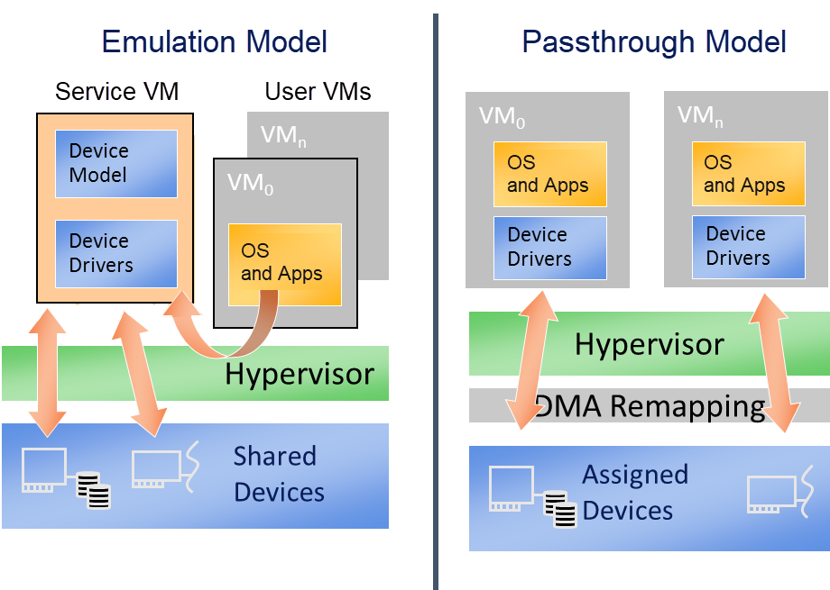
Device Passthrough and SR-IOV
Device Emulation vs Device Passthrough
Image retreived from https://projectacrn.github.io/latest/developer-guides/hld/hv-dev-passthrough.html
Notes:
This slide compares two approaches to virtualizing I/O devices. In the emulation model, the virtual machine interacts with a virtual device model. The hypervisor or service VM handles the translation between the VM and the shared physical device. This approach is flexible because multiple VMs can use shared devices, but it may introduce additional overhead.
In the passthrough model, a physical device is assigned directly to a virtual machine. The VM can use its own device driver and communicate with the hardware more directly. This can reduce latency and improve performance, especially for devices such as GPUs, network cards, and storage controllers. However, passthrough usually gives the device to one VM, so sharing becomes more limited. DMA remapping is used to help keep memory access isolated and secure.

Slide 7
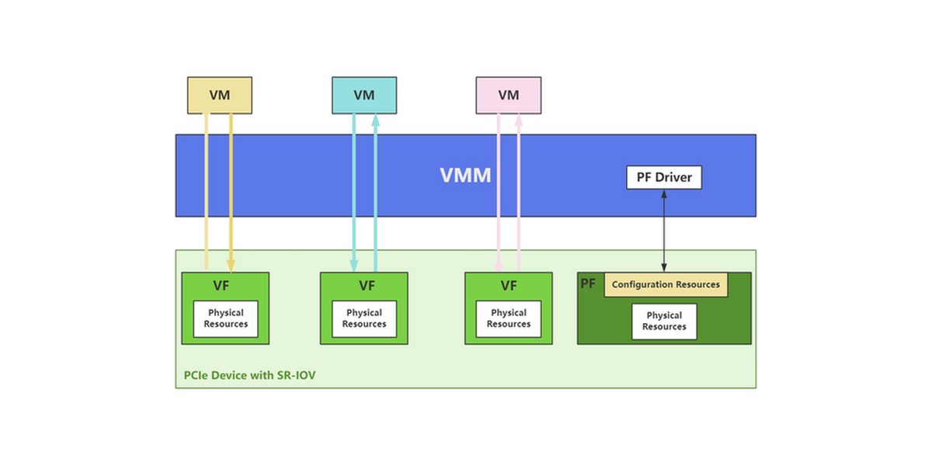
Device Passthrough and SR-IOV
SR-IOV definition
SR-IOV stands for Single Root I/O Virtualization
Allows one physical device to appear as multiple virtual devices
Uses Physical Function (PF) and Virtual Functions (VF)
Each VM can be assigned its own Virtual Function
Improves I/O performance while still supporting device sharing
Image retreived from https://lenovopress.lenovo.com/lp2166-configuring-sr-iov-and-siov-in-vmware-vsphere
Notes:
Device passthrough is a virtualization technique where a physical hardware device is assigned directly to a virtual machine. Instead of fully emulating the device through the hypervisor, the VM can communicate with the real hardware more directly.
This approach can improve I/O performance because the hypervisor does not need to handle every device operation. It is commonly used for devices that require high performance, such as GPUs, network interface cards, and storage controllers. However, because the device is assigned directly to one VM, it is usually not easily shared with other virtual machines at the same time.

Slide 8
Device Passthrough and SR-IOV
Device Passthrough vs SR-IOV
Device Passthrough | SR-IOV
One physical device is assigned directly to one VM | One physical device exposes multiple Virtual Functions
The device is usually dedicated to a single VM | Multiple VMs can share the same physical device
VM uses the physical device more directly | Each VM uses its own Virtual Function
High performance and low latency | High performance with better sharing
Less flexible for multi-VM environments | More flexible for cloud and multi-tenant environments
Common for GPU, dedicated NIC, or storage controller | Common for network virtualization and high-speed I/O
Notes:
Device passthrough and SR-IOV are both used to improve I/O performance in virtualized environments, but they solve the problem in different ways. In device passthrough, one physical device is assigned directly to one virtual machine. This provides high performance and low latency, but the device is usually dedicated to that VM.
SR-IOV is more flexible because one physical device can expose multiple Virtual Functions. Each Virtual Function can be assigned to a different VM, allowing several VMs to use the same physical device more directly. In simple terms, passthrough is one device for one VM, while SR-IOV is one device shared through multiple virtual functions.

Slide 9
Paravirtualized Drivers (VirtIO)

Slide 10
Paravirtualized Drivers (VirtIO)
Paravirtualized Drivers Definition
Paravirtualized drivers are special drivers installed inside the guest OS
They allow the guest OS to communicate efficiently with the hypervisor
The guest OS is aware that it is running in a virtualized environment
VirtIO is a common paravirtualized driver framework
It improves I/O performance for network, storage, and device operations
VM
VM
VM
APP
APP
APP
Guest OS
Guest OS
Guest OS
Modified Drivers
Modified Drivers
Modified Drivers
VMM
VMM Driver Interface
Real Drivers
Hardware
Notes:
Paravirtualized drivers are used to improve communication between the guest operating system and the hypervisor. Unlike full device emulation, where the hypervisor must imitate a physical device, paravirtualized drivers allow the guest OS to use special drivers that are designed for virtualized environments. VirtIO is one common example. It helps improve I/O performance for storage, networking, and other device operations because the communication path becomes more efficient.

Slide 11
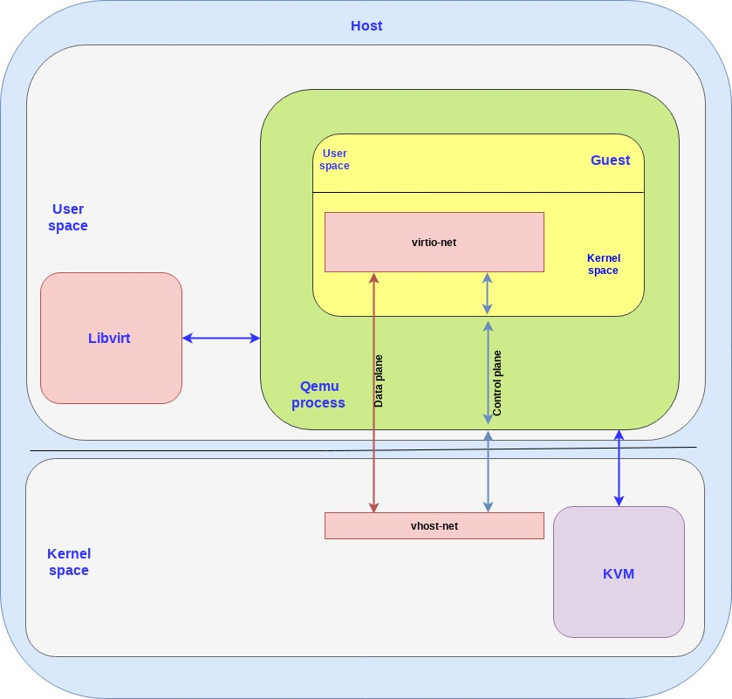
Paravirtualized Drivers (VirtIO)
Paravirtualized Drivers Definition
The guest OS uses a VirtIO front-end driver
QEMU manages the virtual device model
vhost-net handles efficient I/O in the host kernel
Control and data paths are separated
This improves performance compared to full emulation
Image retreived from https://www.redhat.com/en/blog/introduction-virtio-networking-and-vhost-net
Notes:
VirtIO works through cooperation between the guest operating system and the host. Inside the guest, the VirtIO front-end driver handles virtual device communication. QEMU manages the virtual machine and device model, while vhost-net in the host kernel helps process I/O more efficiently. The diagram also shows that the control plane and data plane can be separated, which helps reduce overhead and improve performance compared to full device emulation.

Slide 12
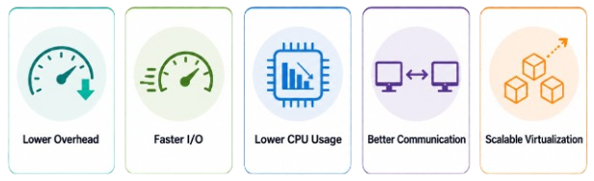
Paravirtualized Drivers (VirtIO)
Advanteges
Notes:
Paravirtualized drivers provide better performance because the guest operating system does not need to interact with a fully emulated physical device. Instead, it uses special drivers designed for virtualization. This reduces the amount of work done by the hypervisor and makes I/O operations more efficient. For example, network and storage operations can be processed faster with lower CPU overhead. This is why paravirtualized drivers such as VirtIO are commonly used in modern virtualization platforms.

Slide 13
Virtualized Interrupts

Slide 14
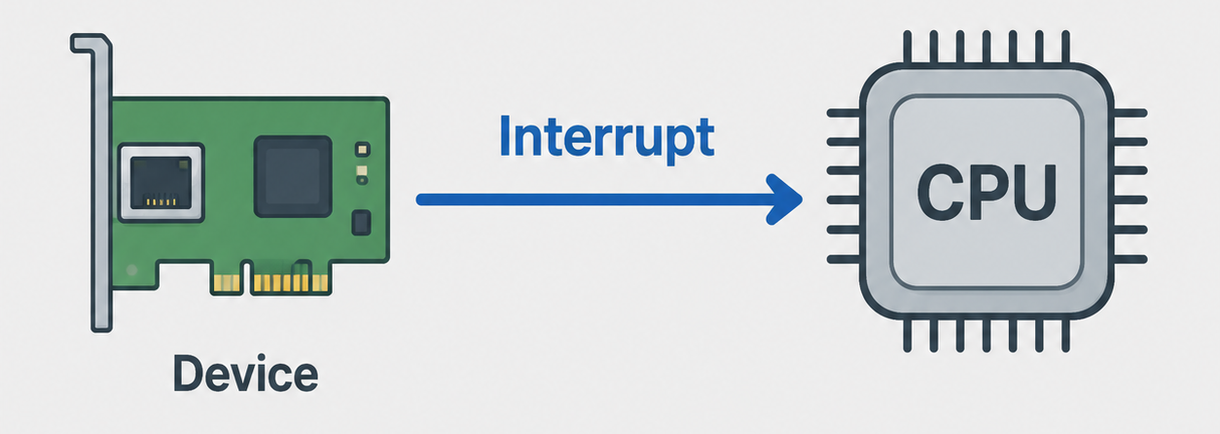
Virtualized Interrupts
Definition
Interrupts are signals sent by hardware devices to the CPU
They notify the system that an event needs attention
Common examples include network packets, disk I/O, and keyboard input
Interrupts allow the CPU to respond without constantly checking devices
In virtualization, interrupt handling becomes more complex
Notes:
Interrupts are signals used by hardware devices to notify the CPU that something needs attention. For example, a network card may send an interrupt when a packet arrives, or a storage device may send an interrupt when an I/O operation is complete. Without interrupts, the CPU would need to constantly check every device, which would be inefficient. In virtualization, interrupt handling becomes more complex because the system must decide which virtual machine should receive the interrupt.

Slide 15
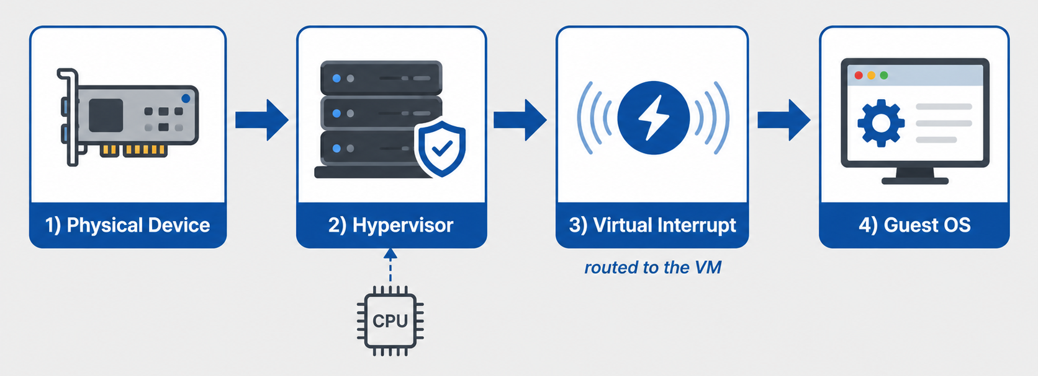
Virtualized Interrupts
How Virtualized Interrupts Work
Notes:
In a virtualized environment, an interrupt does not always go directly from the hardware device to the operating system. Instead, the hypervisor must manage the interrupt and determine which virtual machine should receive it. The physical interrupt is then translated or routed as a virtual interrupt to the guest OS. From the guest OS perspective, it appears similar to a normal hardware interrupt, but in reality, the hypervisor is involved in the delivery process.

Slide 16
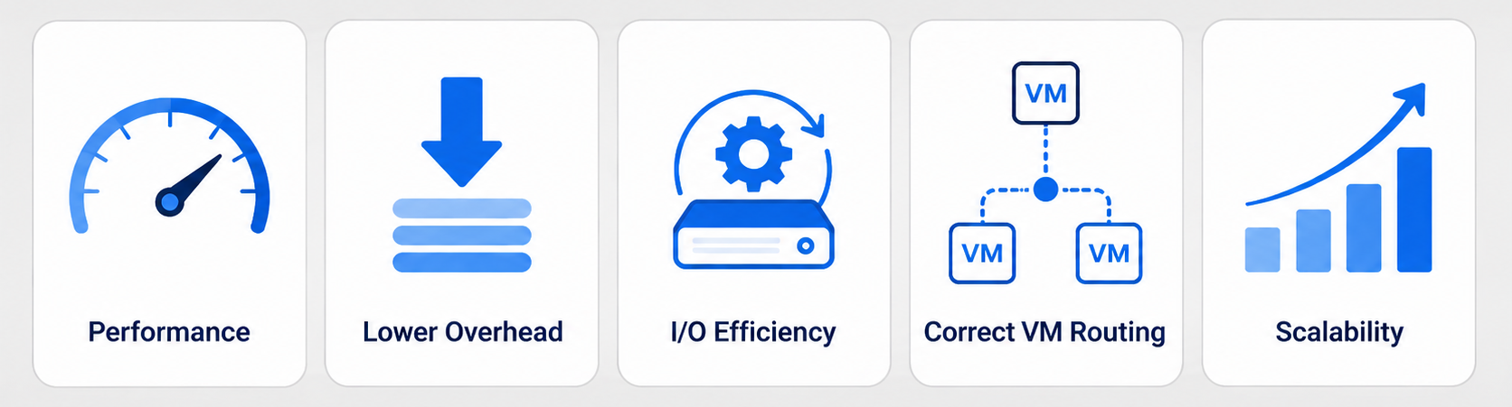
Virtualized Interrupts
Why is it matter?
I/O devices can generate many interrupts
Poor interrupt handling increases virtualization overhead
Efficient interrupt routing improves I/O performance
Important for networking, storage, and high-throughput workloads
Modern virtualization uses hardware support to reduce interrupt overhead
Notes:
Virtualized interrupts are important because I/O-intensive workloads can generate many interrupt events. If every interrupt requires heavy hypervisor involvement, the system may experience additional overhead and reduced performance. Efficient interrupt handling helps virtual machines respond faster to network, storage, and device activity. This is especially important in cloud and data center environments where many virtual machines share the same physical infrastructure.

Slide 17
Port-mapped vs. Memory-mapped I/O

Slide 18
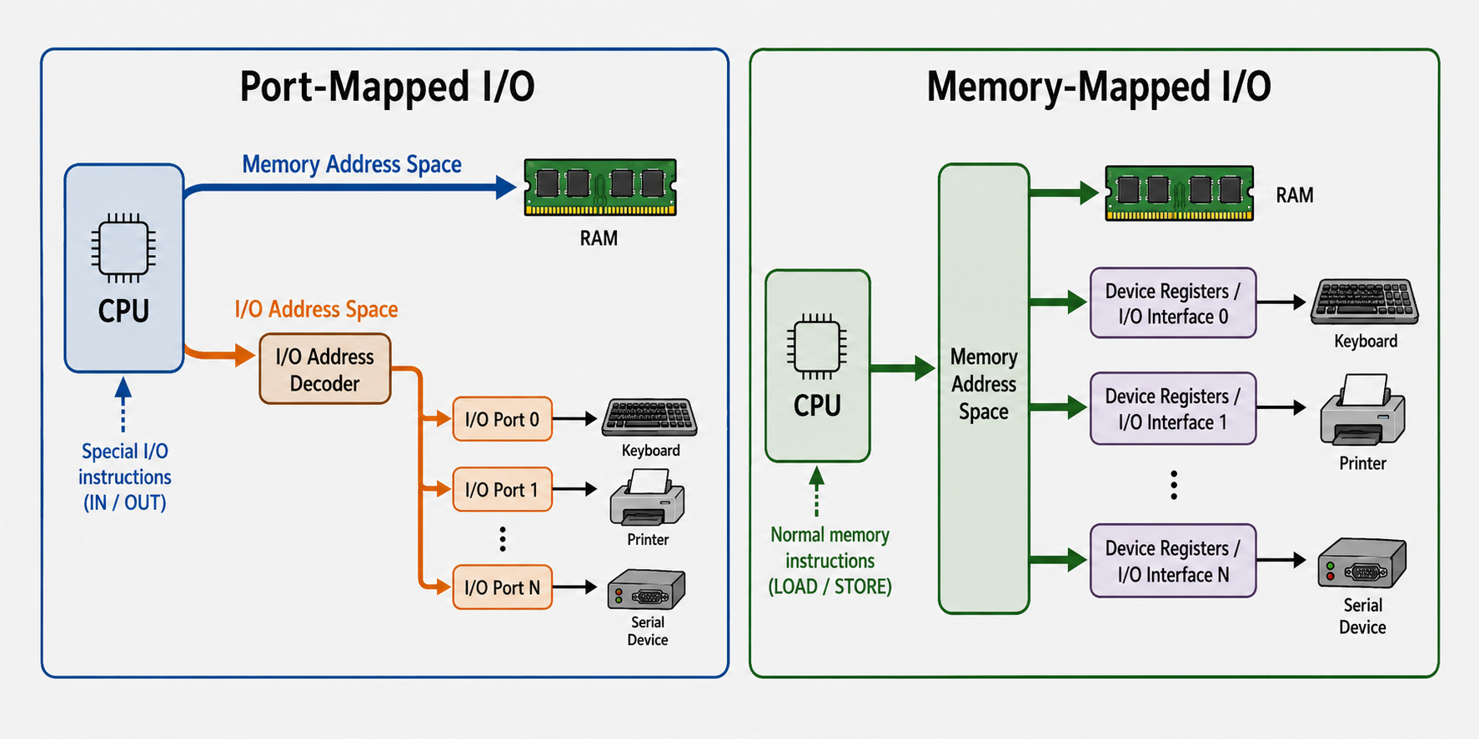
Port-mapped vs. Memory-mapped I/O
Port-Mapped I/O
Uses a separate I/O address space
Devices are accessed through special I/O ports
CPU uses special instructions to read or write I/O ports
Memory addresses and I/O port addresses are separated
Commonly associated with older or specific processor architectures
Notes:
Port-Mapped I/O, also known as isolated I/O, separates memory access from device access. In this model, I/O devices are accessed through special port addresses rather than normal memory addresses. The CPU uses special I/O instructions to read from or write to these ports. This approach makes the separation between memory and I/O clear, but it also requires dedicated I/O instructions and specific handling by the processor and operating system.

Slide 19
Port-mapped vs. Memory-mapped I/O
Memory-Mapped I/O
Uses the same address space for memory and I/O devices
Device registers are mapped into memory addresses
CPU can access devices using normal load and store instructions
Simplifies programming because devices look like memory locations
Common in modern systems and embedded architectures
Notes:
Port-Mapped I/O, also known as isolated I/O, separates memory access from device access. In this model, I/O devices are accessed through special port addresses rather than normal memory addresses. The CPU uses special I/O instructions to read from or write to these ports. This approach makes the separation between memory and I/O clear, but it also requires dedicated I/O instructions and specific handling by the processor and operating system.

Slide 20
Port-mapped vs. Memory-mapped I/O
Port-Mapped vs. Memory-Mapped I/O
Port-Mapped I/O | Memory-Mapped I/O
Uses a separate I/O address space | Uses the same address space as memory
Devices are accessed through I/O ports | Devices are accessed through mapped memory addresses
Requires special I/O instructions such as IN / OUT | Uses normal memory instructions such as LOAD / STORE
Clear separation between memory access and device access | Device registers appear like memory locations
Hypervisor must control access to I/O ports | Hypervisor must control access to mapped device registers
Notes:
Port-Mapped I/O and Memory-Mapped I/O differ mainly in how devices are addressed by the CPU. In Port-Mapped I/O, devices are accessed through a separate I/O address space using special I/O instructions, such as IN and OUT. In Memory-Mapped I/O, device registers are mapped into the normal memory address space, so the CPU can access them using regular memory instructions. In virtualization, both models require hypervisor control to prevent a guest operating system from directly accessing hardware resources without proper isolation.

Slide 21
Exercise
The Interrupt Injection Challenge
In a physical system, a hardware device asserts an interrupt line on the CPU, causing the CPU to immediately stop its current task and run an Interrupt Service Routine (ISR).
Question: In a virtualized environment, if a physical NIC receives data for a VM while that VM is currently not scheduled to run on a physical CPU, how does the hypervisor handle this? What is "interrupt injection"?

Slide 22
References
Erl, T., & Barceló Monroy, E. (2024). Cloud computing: Concepts, technology, security, and architecture (2nd ed.). Pearson.
GeeksforGeeks. (2025, July 23). Difference between memory mapped IO and IO mapped IO with reference to 8085 microprocessor. GeeksforGeeks. https://www.geeksforgeeks.org/computer-organization-architecture/difference-between-memory-mapped-io-and-io-mapped-io-with-reference-to-8085-microprocessor/
Katzer, J. (2021). Learning serverless: Design, develop, and deploy with confidence. O’Reilly Media.
Marinescu, D. C. (2022). Cloud computing: Theory and practice (3rd ed.). Morgan Kaufmann.
Red Hat. (n.d.). Chapter 5. KVM paravirtualized (virtio) drivers. In Red Hat Enterprise Linux 7: Virtualization deployment and administration guide. Red Hat Documentation. Retrieved June 19, 2026, from https://docs.redhat.com/en/documentation/red_hat_enterprise_linux/7/html/virtualization_deployment_and_administration_guide/chap-kvm_para_virtualized_virtio_drivers
Notes:
Port-Mapped I/O, also known as isolated I/O, separates memory access from device access. In this model, I/O devices are accessed through special port addresses rather than normal memory addresses. The CPU uses special I/O instructions to read from or write to these ports. This approach makes the separation between memory and I/O clear, but it also requires dedicated I/O instructions and specific handling by the processor and operating system.

